Slide 1

Team : Outstanding Outliers

Slide 2
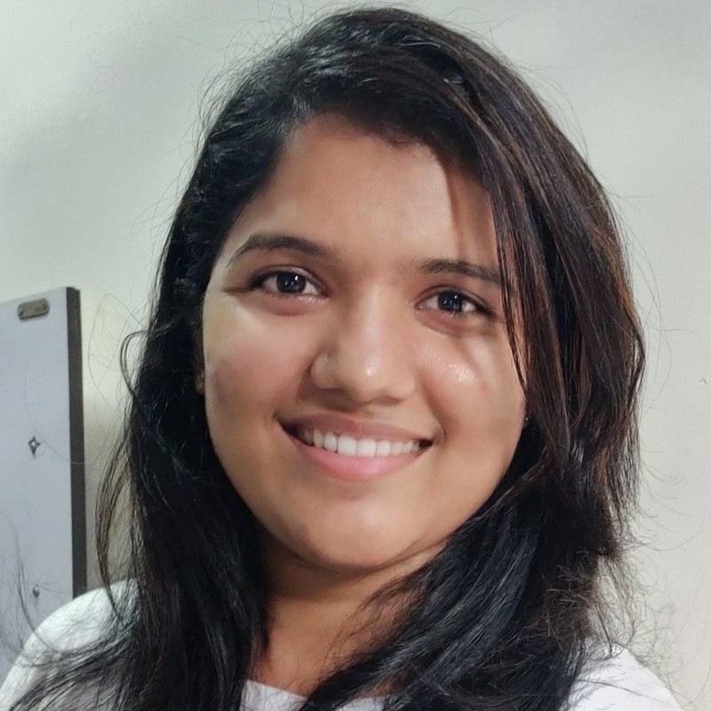
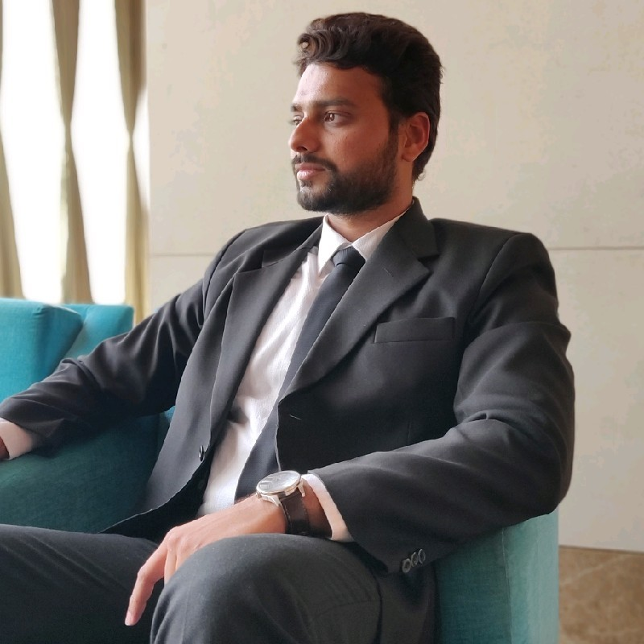


Meet the Team
Sarika Nangare
Nikhil Dalvi
Chandana Nighut
Aniket Naik

Slide 3
What is Travel Insurance? And Why do you Need it?
• Travel insurance provides you with protection against any financial losses due to sudden and unfavourable events related to your journey.
•We don’t want to think the worst, but it’s better to be prepared than sorry!
• Without travel insurance, all your plans could go up in smoke and cost you more than what you’ve already invested into the trip.

Slide 4

Insurance Benefits
Here are some more benefits of having travel insurance:
• Trip Cancellation Protection
• Emergency Medical Coverage
• Trip Delay Protection
Notes:
REMOVE/REPLACE AFF PEACE OF MIND

Slide 5
Problem Statement
To predict whether the customers will report the claim on travel insurance.

Slide 6
Business Problem
In Travel Insurance industry companies take risks over customers.
Automatically predicting the claims from the various travel insurance-related attributes, the model will predict the future claims and can help pricing and risk management team to sanction the claims.
Stakeholders :
CEO,Senior Management
CFO,Head of Finance
Risk Manager
Director of Insurance

Slide 7
Pain Point
Sometimes False claims are getting reported and hence company is experiencing revenue loss however at some time genuine claims are getting reported also leading to lawsuit against the company .
False Positives is harmful for the business and we should look out for it to minimize financial loss.

Slide 8
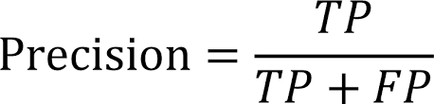
Business and Data Science Metric
Business Metric: Rate of claims sanctioned not more than 10%
Data Science Metric: Precision_score

Slide 9
Data
Dataset Information : The training dataset consists of data corresponding to 52310 customers and the test dataset consists of 22421 customers. Following are the features of the dataset.
Feature | Datatype | Description
ID | int64 | The identification record of every observation.
Agency | object | Name of agency .
Agency Type | object | Type of travel insurance agencies .
Distribution Channel | object | Distribution channel of travel insurance agencies .
Product Name | object | Name of the travel insurance products .
Duration | int64 | Duration of travel
Destination | object | Destination of travel .
Net Sales | float64 | Amount of sales of travel insurance policies
Commision (in value) | float64 | The commission received for travel insurance agency.
Age | int64 | Age of insured (Age)
Target Column y | Datatype | Description
Claim | int64 | Claim Status (Claim) 1(Yes) / 0(No)

Slide 10
Evaluation Metric
The evaluation metric for this project is Precision_score.
False Positive - Predicted as claimed but actually it is not claimed
False Negative - Predicted as not claimed but actually it is claimed
False Positives is harmful for the business and we should look out for it to minimize financial loss for our Company.
 |  | Actual
 |  | Claimed | Not Claimed
Predicted | Claimed | True Positive | False Positive
 | Not Claimed | False Negative | True Negative

Slide 11
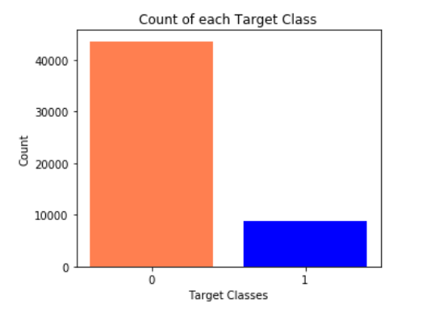

Exploratory Data Analysis
Class Imbalance : The distribution of the target variable shows a clear imbalance in the two classes.
SMOTE and class_weights is used is used to balance the distribution of target variable.

Slide 12
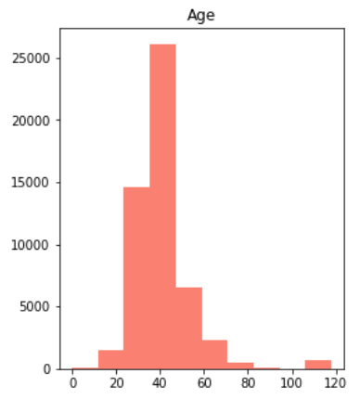
Exploratory Data Analysis
Column : Age
Minimum value = 0
Maximum value = 118
We have assumed that any individual upto age 100 is valid anything above is replaced with median.
Values in Age Column are Categorized as :
Age | Category
0 - 17 | Child
18 - 24 | Youth
25 - 34 | Professionals
35 - 44 | Adult(35 - 44)
45 - 54 | Adult(45 - 54)
>54 | Senior

Slide 13
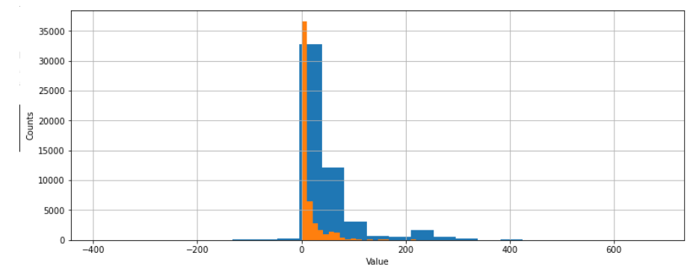
Exploratory Data Analysis
Net Sales vs Commission reported
These both column seems to related but the graph plot shows disparency as low net sales shows high commission.

Slide 14
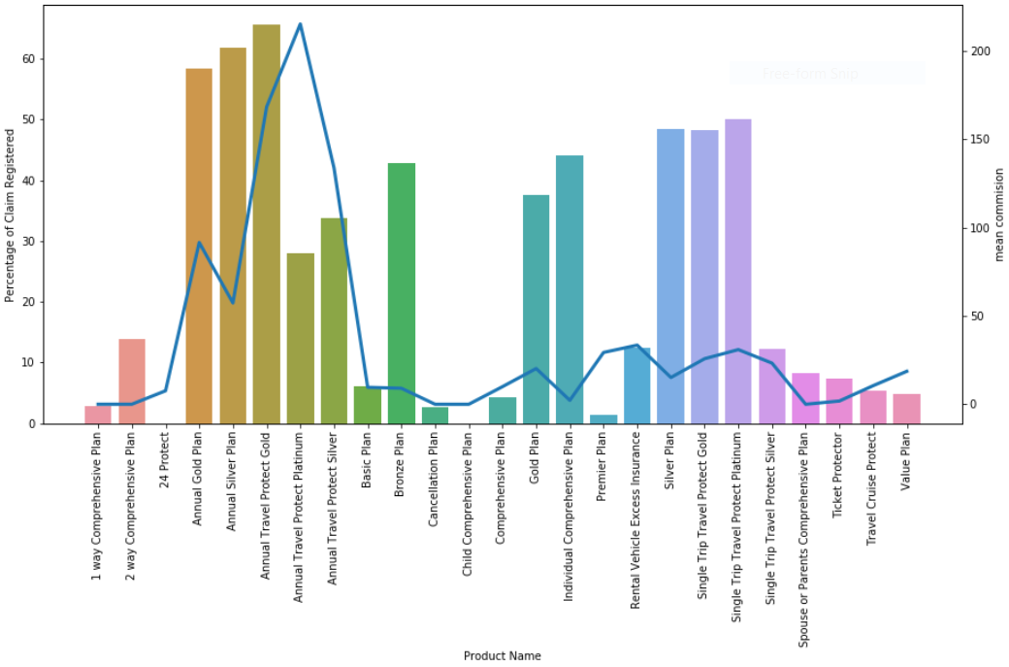

Exploratory Data Analysis
Distribution of Claim and Commission as per Product Name
Annual Gold and Annual Silver Plans have higher no. of Claims registered whereas commission drawn is very low.
Annual Travel Protect Platinum Plan has low no. of Claims registered whereas commission drawn is very high
Notes:
Claims reported and mean commision as per product name

Slide 15
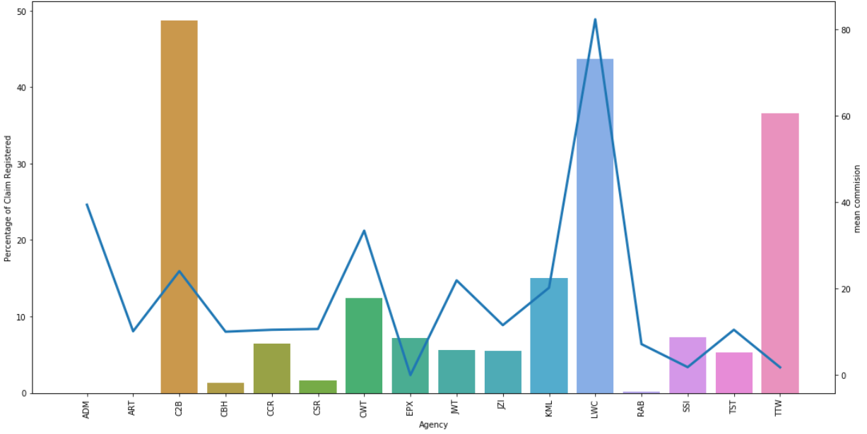
Exploratory Data Analysis
Distribution of Claim and Commission as per Agency
- Certain agencies have less registered claims but they draw commission on the Insurance Policies.(CBH, CSR, CWT, JWT)
- ADM, ART has no registered claim but commission is high
- Certain agencies have higher percent of registered claims but the mean commission is very low(C2B, TTW)
- Claim and Mean Commission is high for LWC.
Notes:
Claims reported and mean commision as per Agency

Slide 16
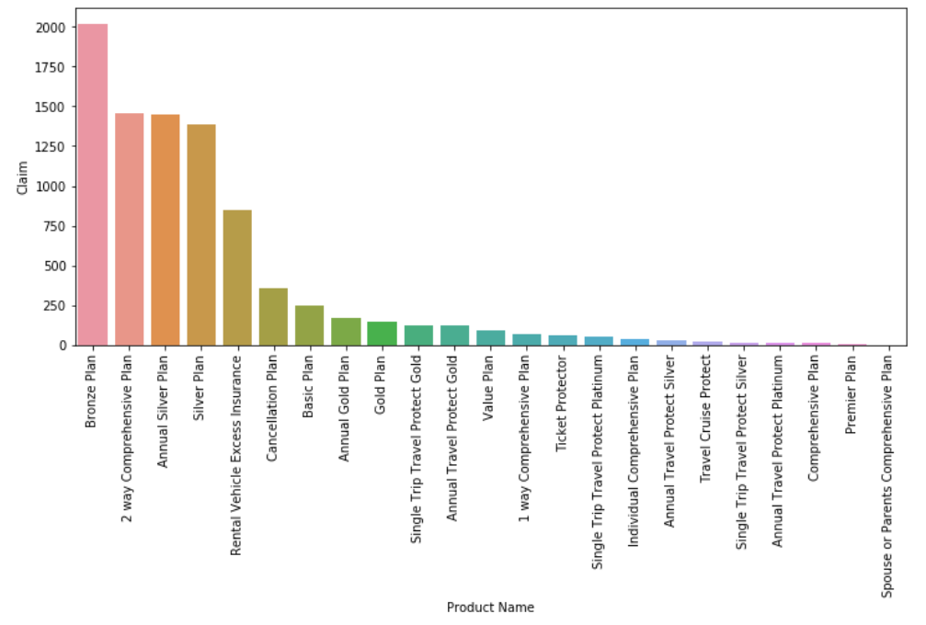
Exploratory Data Analysis
Relation between registered Claims and Product Name
Bronze Plan, 2 way Comprehensive Plan, Annual Silver Plan has highest claims reported.
Notes:
Which product has highest claims reported?

Slide 17
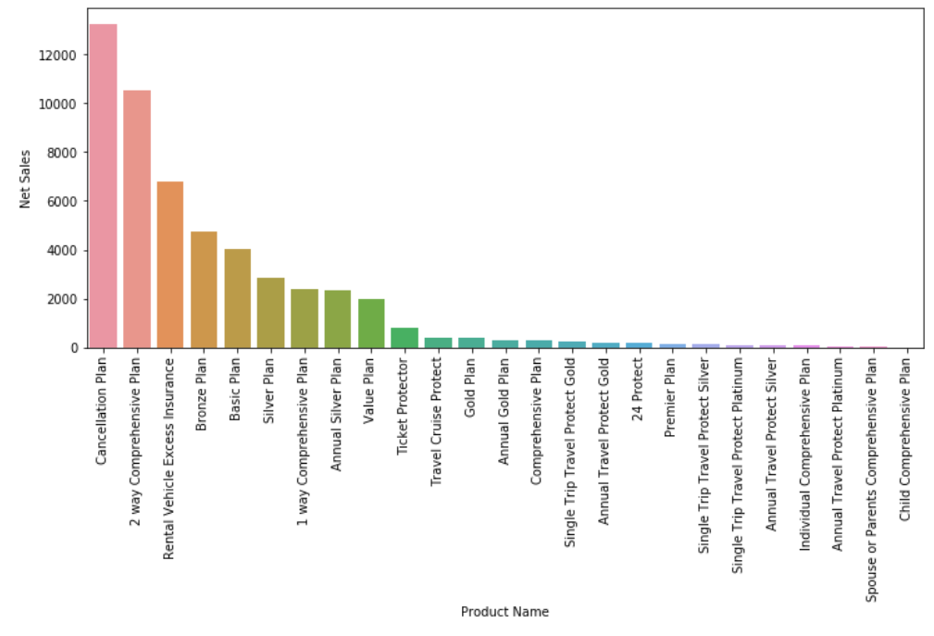
Exploratory Data Analysis
Products vs Net Sales.
As Cancellation Plan and 2 way comprehensive plans are contributing more in Sales.
Even Cancellation plan has less claims so Agencies should focus more on this plan.
Notes:
Which product has maximum net sales ?

Slide 18
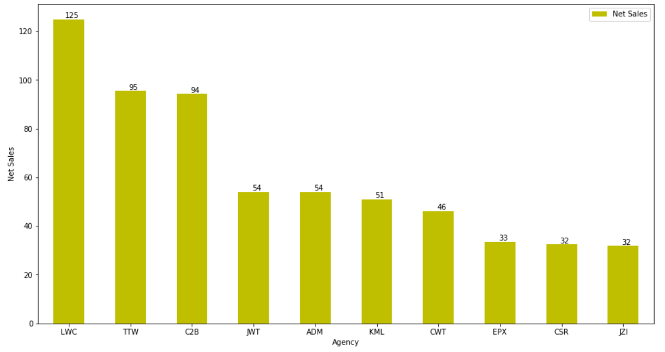
Exploratory Data Analysis
Agencies with the maximum number of Net Sales.
The Agencies with Top 5 Net Sales were LWC,TTW and C2B.
Notes:
Which agency has maximum number of net sales?

Slide 19
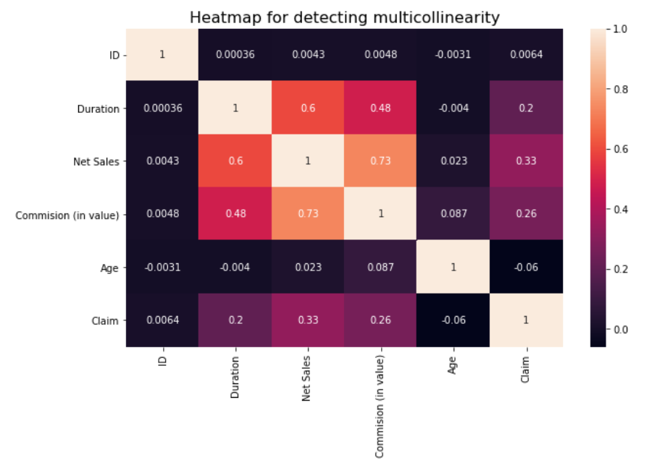
Feature Selection
There is no high correlation between any features and hence we can continue with all of the above features to train our model.
ID column has very low correlation with other features, so it has been dropped.

Slide 20
Models and Approaches
Four vanilla models were assessed without performing any hyperparameter tuning and without treatment of class imbalance of the target. The models were
Logistic Regression
Random Forest Classifier
XGBoost Classifier
AdaBoost
None of the four vanilla models were able to give an Precision score above 75% on actual test data.
This called for performing hyperparameter tuning using Grid Search and also treatment of class imbalance using SMOTE and Class weights for further improvement of the Precision score and ROC_AUC score.

Slide 21
Model Score
Models Assessed : The vanilla models used yielded the following results below.
Modelling Method | Precision | Recall | AUC_ROC
Logistic Regression | 0 - 0.92 1 - 0.68 | 0 - 0.94 1 - 0.61 | 93.65%
Random Forest Classifier | 0 - 0.96 1 - 0.74 | 0 - 0.94 1 - 0.81 | 95.82 %
XGBClassifier | 0 - 0.95 1 - 0.80 | 0 - 0.96 1 - 0.72 | 96.05 %
AdaBoost Classifier | 0 - 0.60 1 - 0.88 | 0 - 0.95 1 - 0.37 | 86.53 %

Slide 22
Model Tuning
After performing hyperparameter tuning using Grid Search and treating imbalanced classes also RF with Class Weights and SMOTE along with Ensemble model of GradientBoostingClassifier and Adaboost yielded the following results:
Modelling Method | Precision | Recall | ROC_AUC
Logistic Regression with GridsearchCV | 0 - 0.86 | 0 - 0.97 | 76.7%
 | 1 - 0.61 | 1 - 0.22
Random Forest | 0 - 0.96 | 0 - 0.95 | 95.98 %
Classifier with SMOTE | 1 - 0.75 | 1 - 0.80
Random Forest Classifier with Class weights | 0 - 0.94 | 0 - 0.97 | 83.51 %
 | 1 - 0.84 | 1 - 0.70
Ensembling(GBC on Adaboost Classifier) | 0 - 0.95 | 0 - 0.98 | 96.69 %
 | 1 - 0.87 | 1 - 0.75

Slide 23
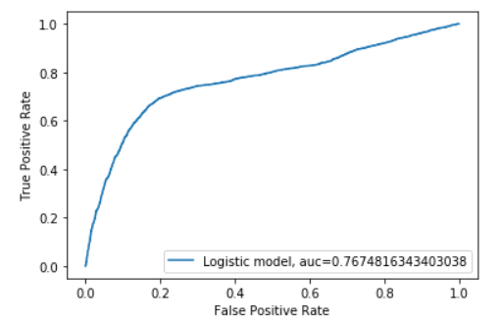
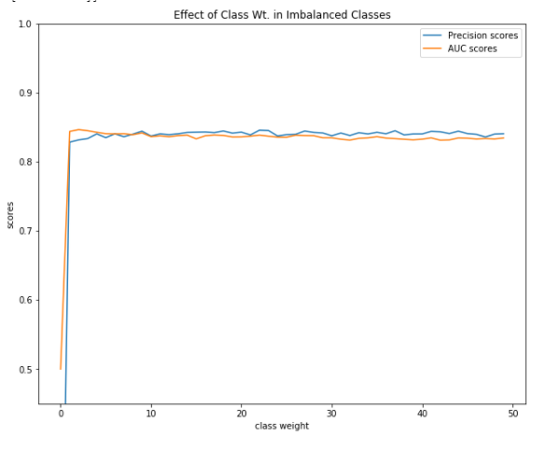
Evaluation & Results
Below are the precision score plots for the after hyperparameter tuning.
Logistic Regression with GRidSearchCV
Random Forest with Class weight

Slide 24
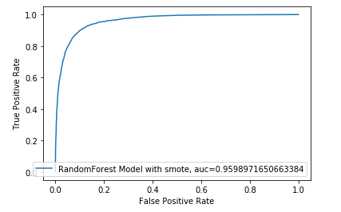
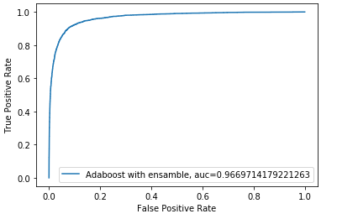
Random Forest with SMOTE
Ensemble model with GBM and Adaboost

Slide 25
Final Results
From the above observations and plottings it can be inferred that the best performing model was AdaBoost with GBC (Ensemble)giving an precision score of 88 %. While AdaBoost is used , it is always prudent to start from simpler algorithms and then go to complex ones.
Confusion Matrix :
 | Predicted Positive | Predicted Negative
Actual Positive | 2175 | 707
Actual Negative | 357 | 14024

Slide 26
Insights and Recommendations
Insight: From the Age Claim visualizations it is evident that 30-45 age group travel most and have maximum claim registered.
Recommendation:Insight So for this age group we can increase the premium and commission charges on the claimed insurance.
Offer more lucrative discounts and schemes to other age groups for boosting the Net Sales.
Insight :Cancellation Plan is the most selling one and the claims registered are less.
Recommendation:Agencies with low Net Sales should sell the products which are highly sold and has low claim rates.(Cancellation Plan).This will maximize profit.

Slide 27

Thank you .
Outstanding Outliers:
Sarika Nangare
Chandana Nighut
Nikhil Dalvi
Aniket Naik

